Slide 1

SKCMDb
Interoperability of Music Libraries and Archives with Public and Private Music Services
Presented by Antal, Dániel CFA (Reprex B.V.)
Team members Mester, Anna Márta (Reprex B.V.) Žilková, Anna (Music Centre Slovakia)
IAML 2025, Salzburg
DOI: 10.5281/zenodo.16634558

Slide 2
From A Feasibility Study To Data Exchange
01

Slide 3
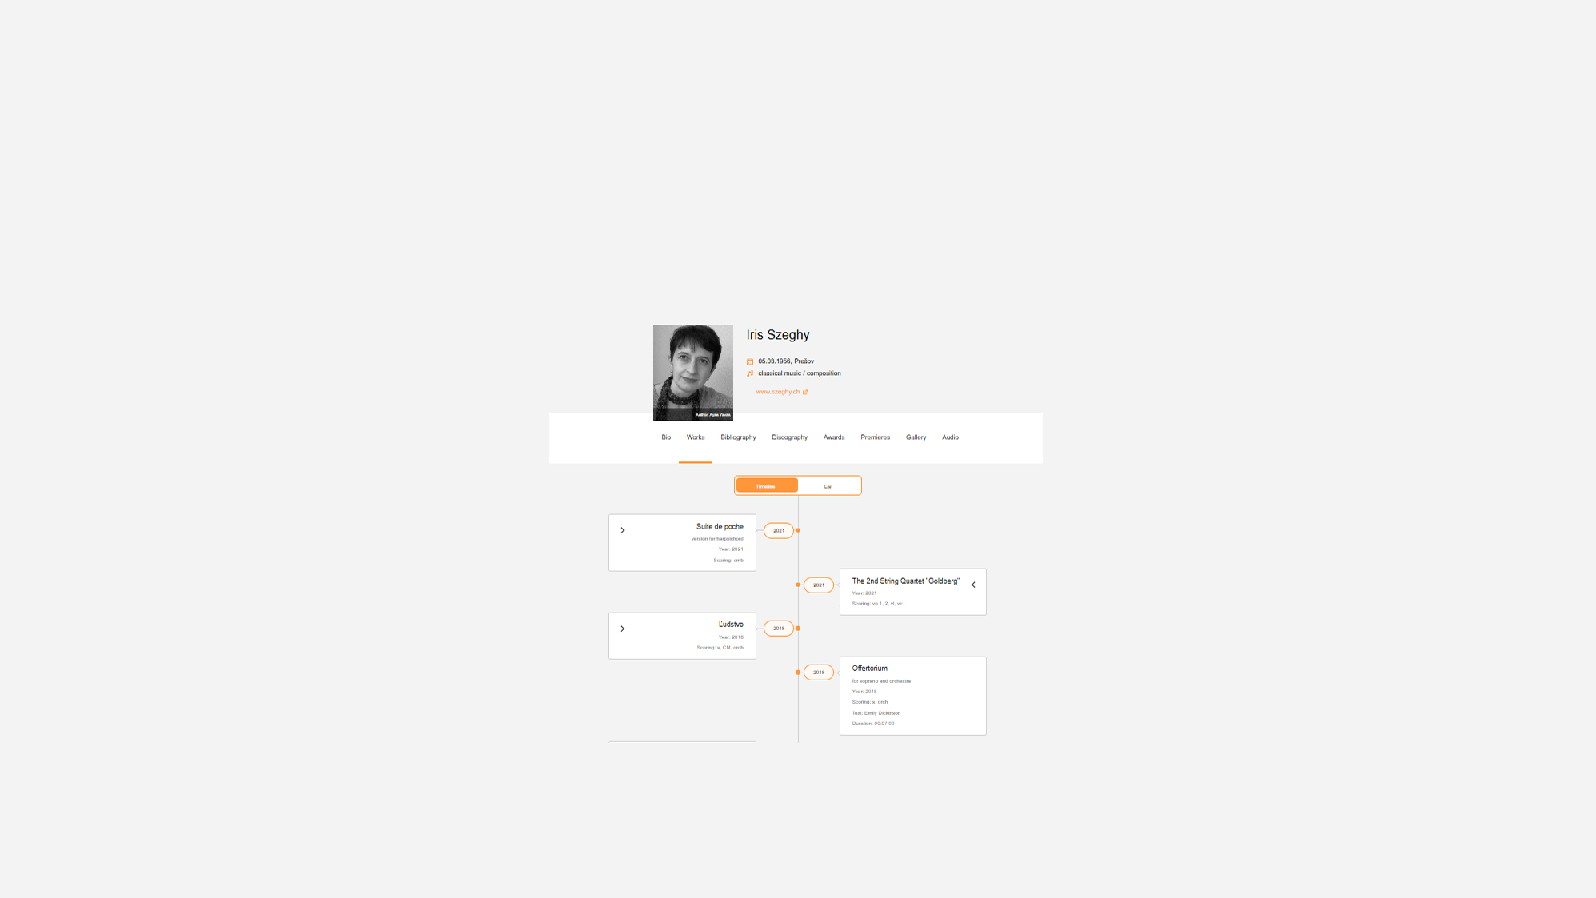


















Data sharing and exchange in the Slovak music data sharing space
Data health checks
Ensure that streaming services can recommend the music and pay out artist
Printed music
Increase the availability of printed music via webshops and library access
Improve recommendations
Music info center sends authoritative repertoire data
Integrate libraries
Enable search in libraries and archives, locate printed music and records for public lending
Improve statistics
Satellite business register coordination for better surveys of music
Local content regulation
Help radio stations to comply with legal local content quotas.

Slide 4
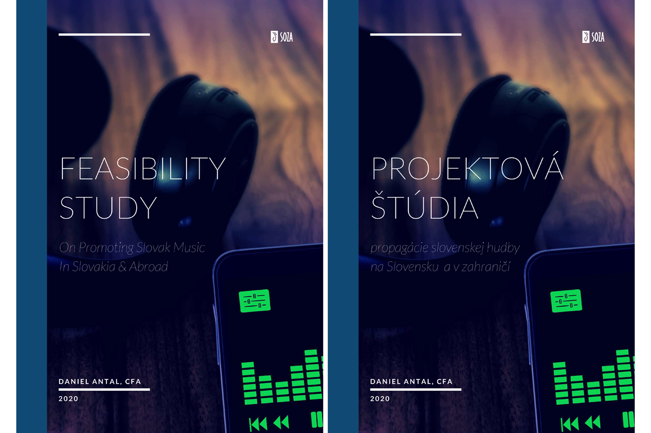
Sustainability
Why do they not recommend music from Slovakia in Slovakia for Slovak people?
How can we avoid that small repertoires lose their original market, their only market?
Findings
Small repertoires have very low-quality data representation
Because of low income, data improvement and documentation must not be expensive
Public-Private Partnership is needed to solve data problems

Slide 5
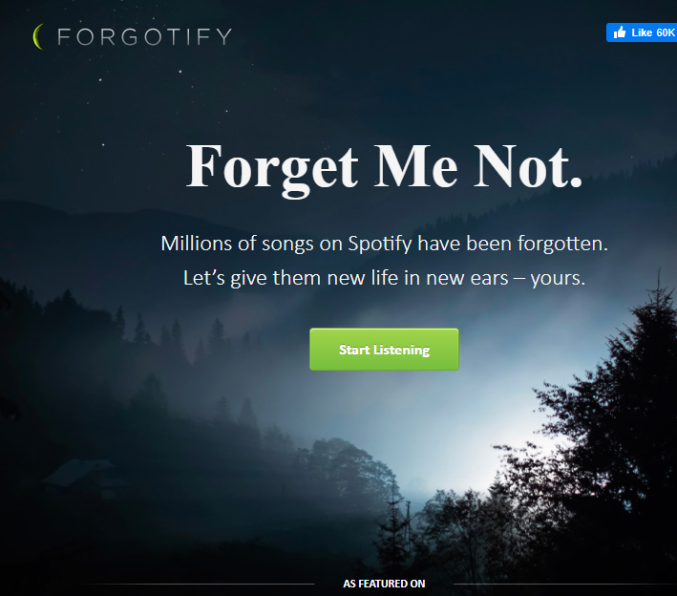
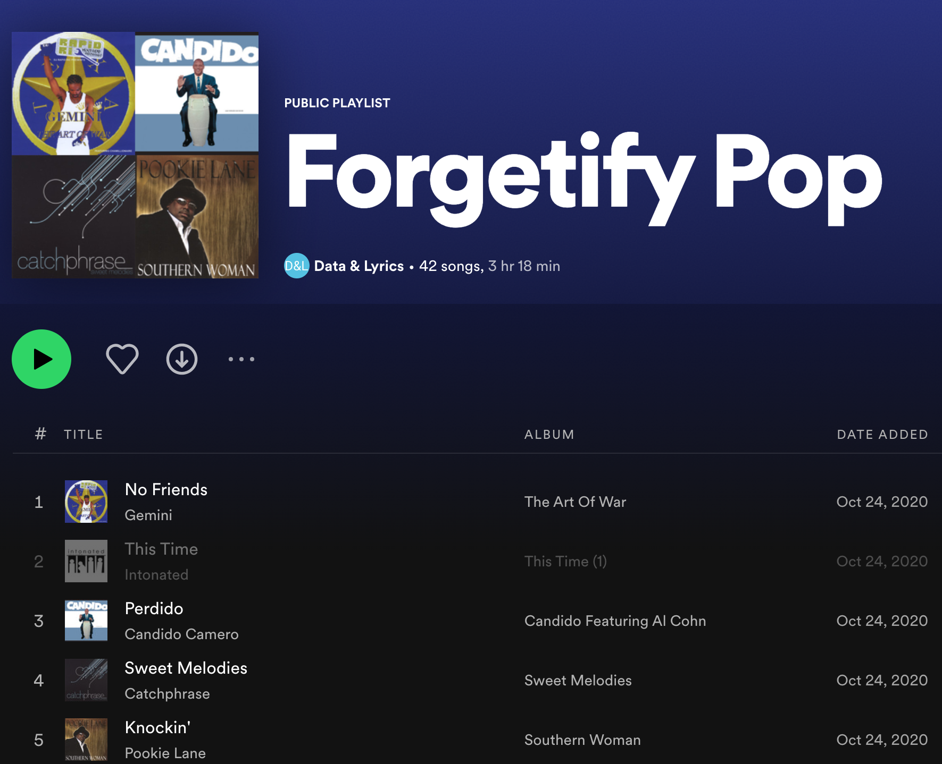
The opposite of success
It is often hard to say what would be a perfect metadata, or what we want to do with the data.
We started with the nightmare scenario: that a new release ends of on Forgotify, a funny service that plays songs which had never been played on Spotify.
We realised that many songs, often gold records, end up here with wrong data, because recommender systems place them on the wrong shelf and recommend them to an inappropriate audience.

Slide 6
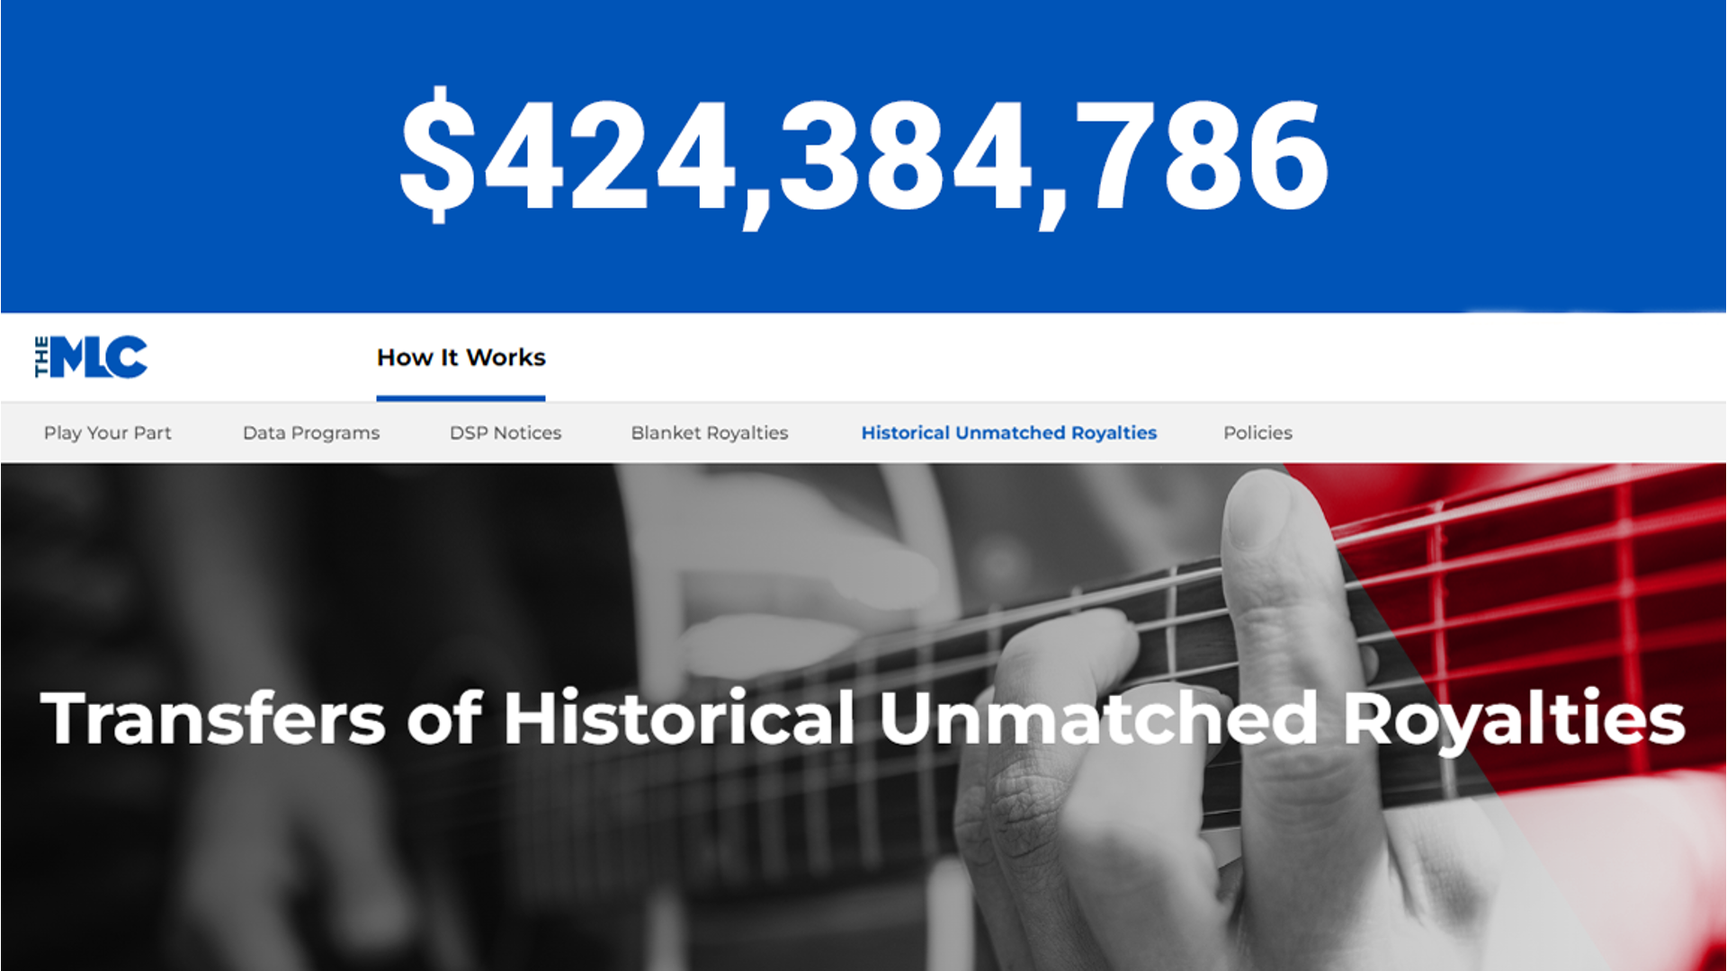
What is at stake?
Wrong metadata comes with a cost. In the first 18 months of MLC, it returned a very large amount to mainly independent artists.
Our experience shows in Slovakia that similar proportions of the royalties may be late or lost due to data problems.
Often, royalties are not collected because of the high collection cost compared to the outstanding sum. We want to make royalty collection much cheaper.

Slide 7


With big data problems everybody is small
01 Problems with ddata
100,000 sound recording Spotify: per day Europeana: 10 years
The Slovak Music Dataspace is designed as a PPP, and we hope to initiate at least metadata cooperation between the private and public sector.
Csak az EU-ban
49 000 cégnek kell felelősséget vállalniuk, hogy teljes ellátási láncuk megfeleljen az ESRS-nek
Az ellátási lánc nagysága ~ 23 000 000 cég ~1 000 000 civil szervezet
~1 000 000 köztestület
[Sanitized]
### very few
Ontology engineers
Information scientists
Data steward and engineer
statistician
is available, so cooperation is imperative
We are looking for ways for public and private metadata improvements

Slide 8
Building the Slovak Comprehensive Music Database
02

Slide 9
Public-Private Partnership for trustworthy music data
04 Data coordination & interoperability
We create data (sharing) spaces that not only follow the models of the European Interoperability Framework and EOSC but extend to interoperability with private partners
Open Music Observatory
Our solution involves the creation of a data sharing space operated by a permanent observatory.
Open Science
Many disciplines study music, including in Open Music Europe, and we would like to reuse their data. We see the reuse of information models and ontologies for metadata improvement the most promising, because ontology development is more suitable for basic research than business.
EOSC Open Science
Coordination of privately-held and public sector data
The Data Governance Act and various statistical regulations allowing novel data coordination between privately-held and governmental data. We want to facilitate “experimental statistics” and novel music library products to help metadata-poor rightsholders to become competitive in the digital space.
Public sector information reuse (open data)
The Open Data Directive (2019/1024/EU), the Data Governance Act (2022/868/EU) gives legal access to much data for free or at marginal cost, however, these valuable data assets need to be reprocessed to be useful for the music sector.
Collective management, publishers, labels, “Unlabel”
EIF Public sector information reuse

Slide 10
Public-Private Partnership for Trustworthy Music Data
We create data (sharing) spaces that not only follow the models of the European Interoperability Framework and EOSC but extend to interoperability with private partners
Open Music Observatory
Our solution involves the creation of a data sharing space operated by a permanent observatory.
Open Science
Many disciplines study music, including in Open Music Europe, and we would like to reuse their data. We see the reuse of information models and ontologies for metadata improvement the most promising, because ontology development is more suitable for basic research than business.
EOSC Open Science
{{< pagebreak >}}
Coordination of privately-held and public sector data
The Data Governance Act and various statistical regulations allowing novel data coordination between privately-held and governmental data. We want to facilitate “experimental statistics” and novel music library products to help metadata-poor rightsholders to become competitive in the digital space.
Public sector information reuse (open data)
The Open Data Directive (2019/1024/EU), the Data Governance Act (2022/868/EU) gives legal access to much data for free or at marginal cost, however, these valuable data assets need to be reprocessed to be useful for the music sector.
Collective management, publishers, labels, “Unlabel”
EIF Public sector information reuse

Slide 11
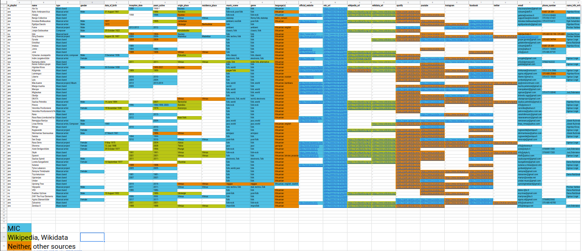
Case study: MIC Information Could Be Improved

Slide 12
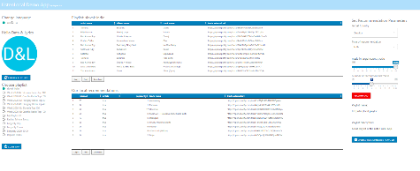
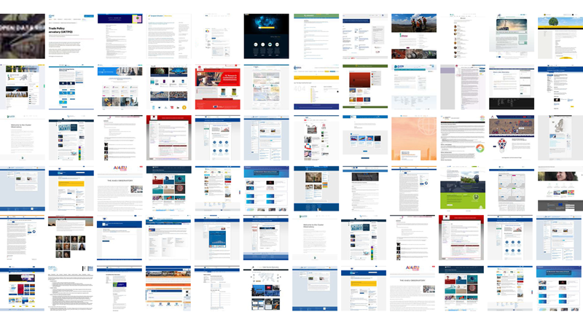
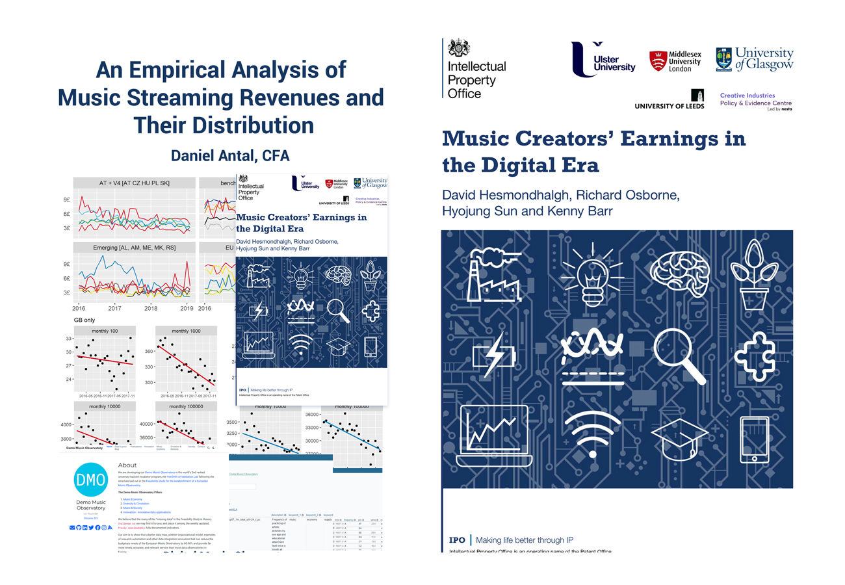
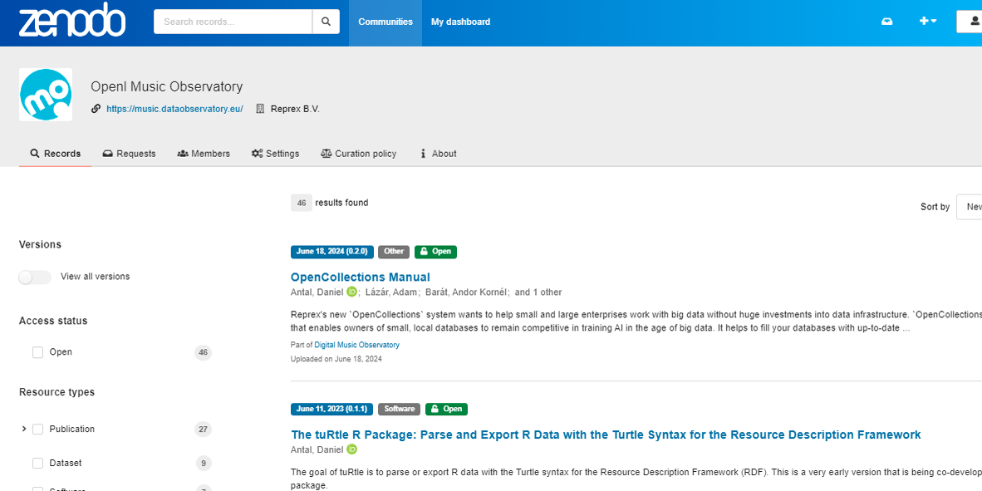

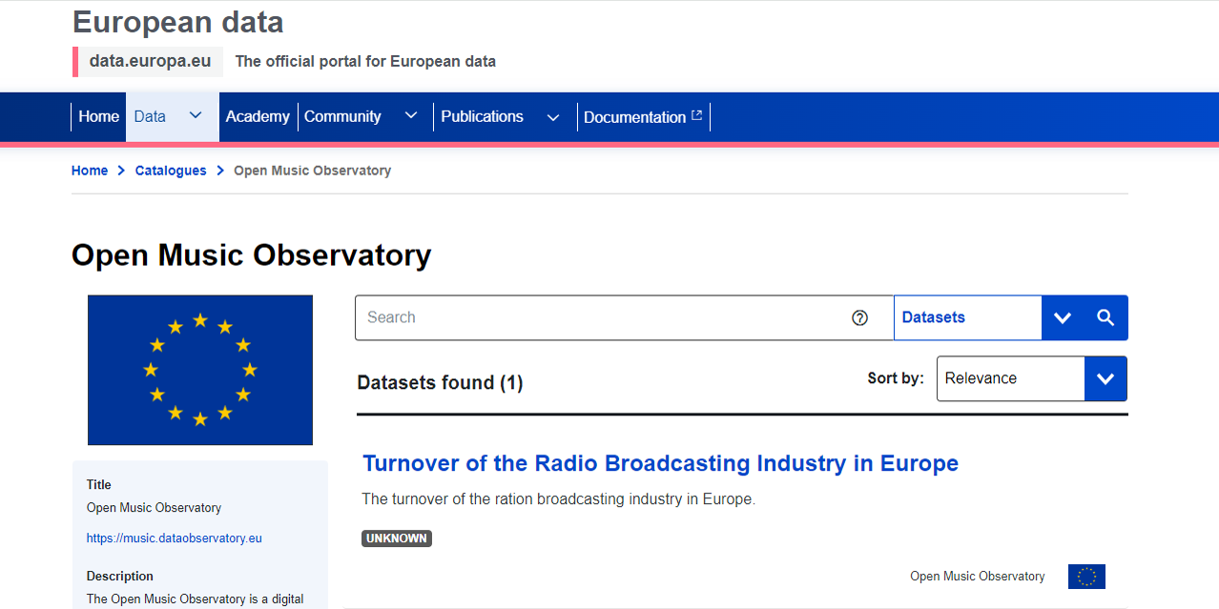




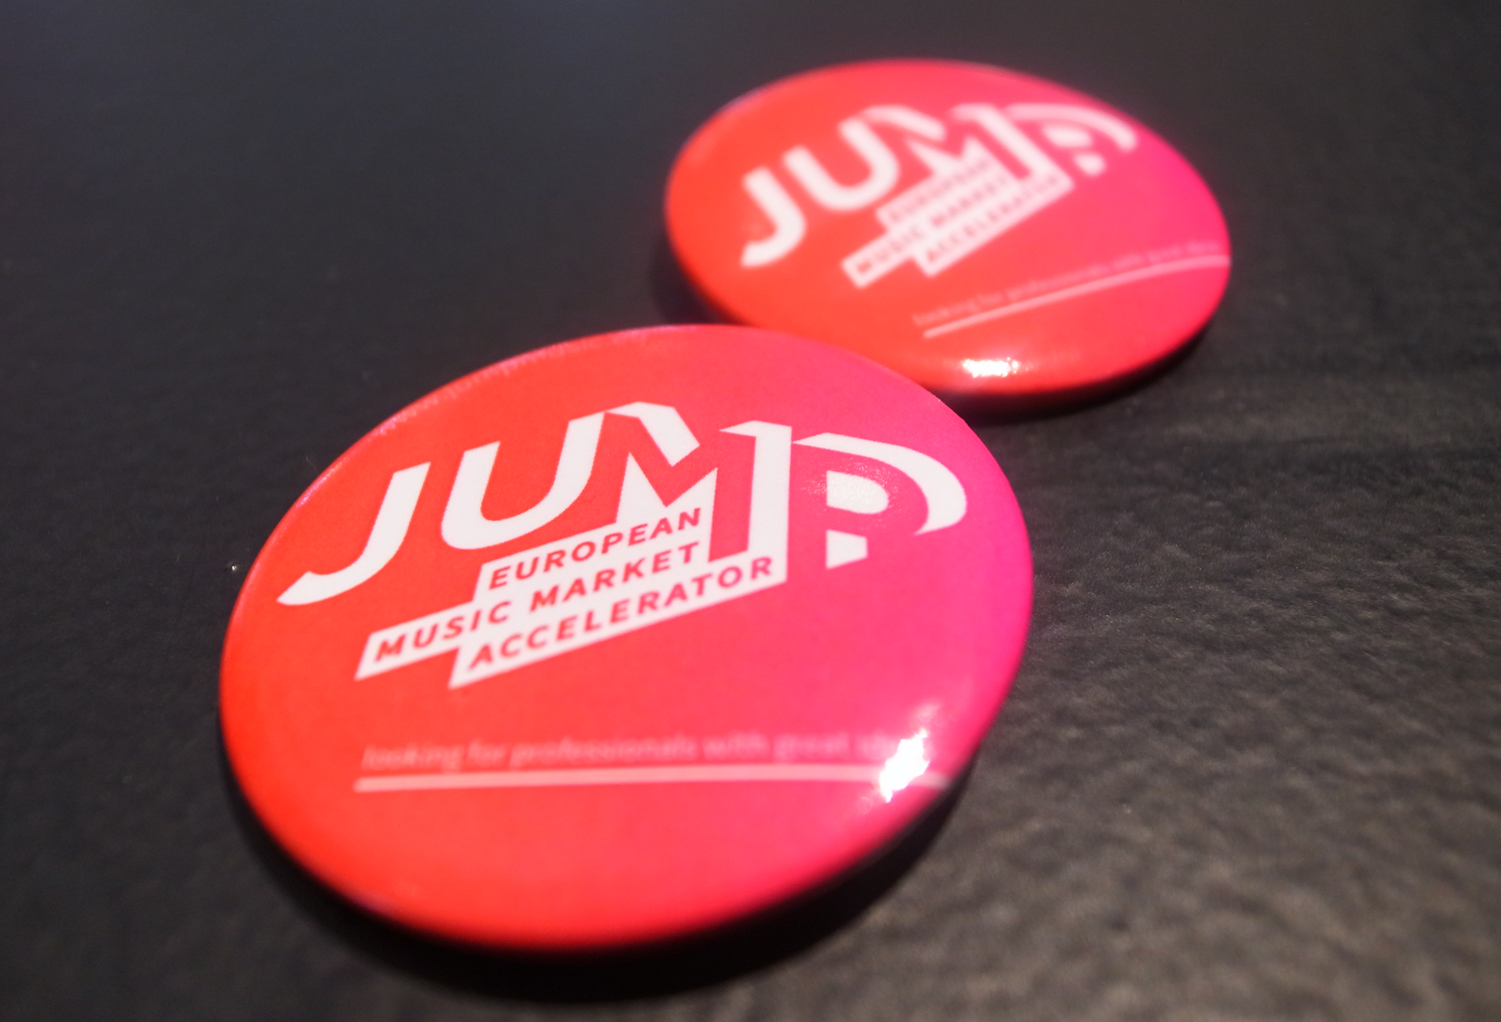
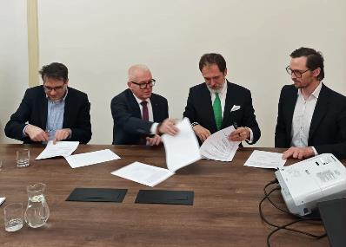
Open Music Observatory Timeline
From CEEMID via Open Music Europe towards a decentralised music observatory data sharing space
2014
2018
2019
2020
2021
2022
2023
2024
2025
2026
Memorandum of Understanding
Hungarian Music Industry Report
Hungarian Private Copying valuation series
Croatian PCR Report
DOI:10.5281/zenodo.10284382
Slovak Music Industry Report
CEE Report
DOI:10.13140/RG.2.2.21450.31686
Feasibility Study,
Eu best practice,
Yes!Delft AI Lab
Digital Music Observatory,
JUMP Music Market Accelerator,
SK Feasibility Study
Various Use Cases,
Grant Application
Open Music Europe
Open Music Observatory
Open Music Observatory
applications
Full European federation
Music Moves Europe
Triple Transition
Feasibility studies
Horizon Europe call
DGA, EIF Act
Open Music Europe
AI Act
CSRD

Slide 13
Slovak Music Dataspace
A space to share data securely among Slovak data owners
Slovak Music Dataspace
„A dataspace is an emerging approach to data management. To reduce the initial effort required for data integration, it offers a set of legal, organisational, semantic, and technical protocols to map the potential benefits of a future data exchange.
In the data (sharing) space, data integration only happens on an "as-needed," "as-permitted," or "as-agreed" basis, with some of the labour or negotiation-intensive data integration aspects postponed until they are genuinely needed. ”
SOZA
data systems
Hudobný fond
webshop
Slovak Comprehensive Music Database SKCMDb
Wikidata Wikipedia SK
Hudobné centrum website, library & webshop
Spotify API
Bratislava City Library
Music Brainz
Kosice Public Library

Slide 14
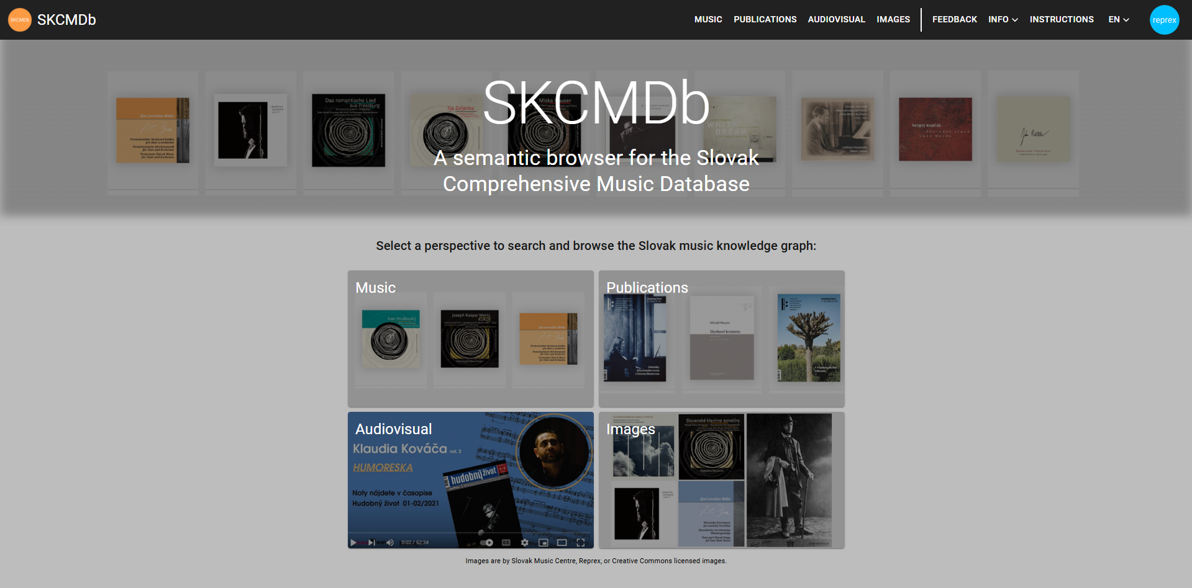

























Dataspace for the European music sector
public service integration Application layer private service integration
Our ReprexBase system combines Wikibase with a peer-reviewed set of software libraries for statistically valid indicator production, impact and materiality testing.
Enterprise and open graph coordination
Our peer-reviewed, scientific software libraries and ontological patterns standardise the data
Data curation

Slide 15
Ontological Modelling and Metadata Pragmatics
03

Slide 16




Data curation is the organisation and integration of data collected from various sources.
It involves annotation, publication and presentation of the data so that the value of the data is maintained over time, and the data remains available for reuse and preservation.

Slide 17
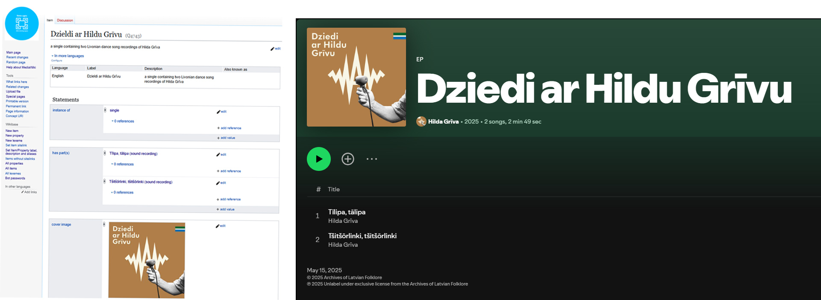
Broad Interoperability: From Archive To Spotify
Our data model supports only “patterns” of important standard library, archive, museum, rights management conceptual models; functionality is not optimised for libraries but for cross-institutional use

Slide 18
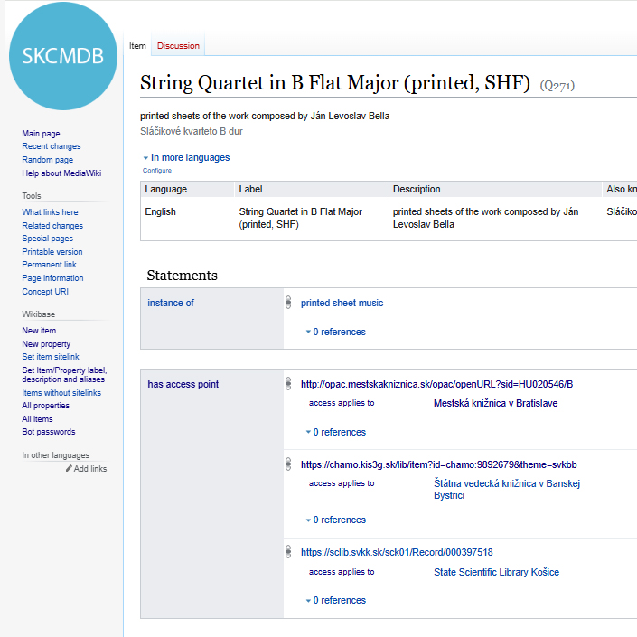
DCTERMS patterns
Allow sufficient mapping to/from DCTERMS and interoperability with other industry and domain standards like DDEX, Wikidata, Polifonia, RiC and CIDOC
No new ontology development
Use eXtreme Design for designing system competencies
Ontological patterns to pragmatically work with music distributors and rights managers who work with DDEX
For cultural sector, with CIDOC museums, old ISAD(G) and RiC archives
DCTERMS / DataCite for EOSC – Dariah data
DCTERMS / Europeana

Slide 19
Multilingual Geographic Reconciliation
Slovak | Hungarian | German | Ukrainian / Ruthenian | GeoNames | VIAF ID
Slovensko | Szlovákia | Slowakei | Словаччина | 3057568 | 130796284
Bratislava | Pozsony | Pressburg | Братислава | 3060972 | 126115307
Košice | Kassa | Kaschau | Кошиці / Кошице | 724443 | 243674873
Prešov | Eperjes | Preschau | Пряшів | 723846 | 238550385
Levoča | Lőcse | Leutschau | Левоча | 724443 | 240359380
Komárno | Komárom | Komorn | Комарно | 3058716 | 230898250
Bardejov | Bártfa | Bartfeld | Бардіїв | 722433 | 234326796
Trebišov | Tőketerebes | Trebischau | Требішів | 723500 | 236151935
Michalovce | Nagymihály | Großmichel | Михайлівці | 724510 | 236047544
Rožňava | Rozsnyó | Rosenau | Рожнява | 723187 | 239602891
Library records are often “timecapsules”
Ľudovít Rajter (1906–2000), a Slovak composer and conductor.
Born in the Hungarian Kingdom (Austria-Hungary), citizen of Czechoslovakia and Slovakia. Studied in Hungary, his name was also used as “Rajter Lajos”.
Birthplace is recorded as “Pezinok” in Slovak, “Bazin” in Hungarian, and “Bösing” in historical German sources.
Geographical, corporate body names, and married names change over her lifetime.
A convergence to the same identifier (“named-entity ambiguity resolution”) is not only needed for international federation, but for understanding historical records.

Slide 20
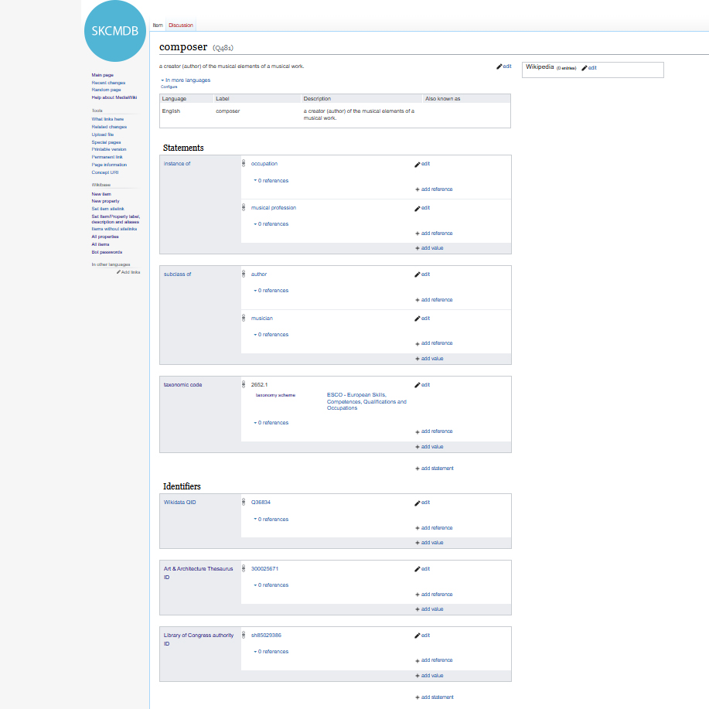
Thesaurus Patterns
Allow sufficient mapping to/from library, heritage and music applications
Getty AAT: 300025576 (researchers) http://vocab.getty.edu/page/aat/300025576
MUIS.EE: the thesaurus of the Estonian museum system http://opendata.muis.ee/thesaurus/203/13580
ESCO: textile researcher
NACE: 72.2 research and development on humanities and arts

Slide 21
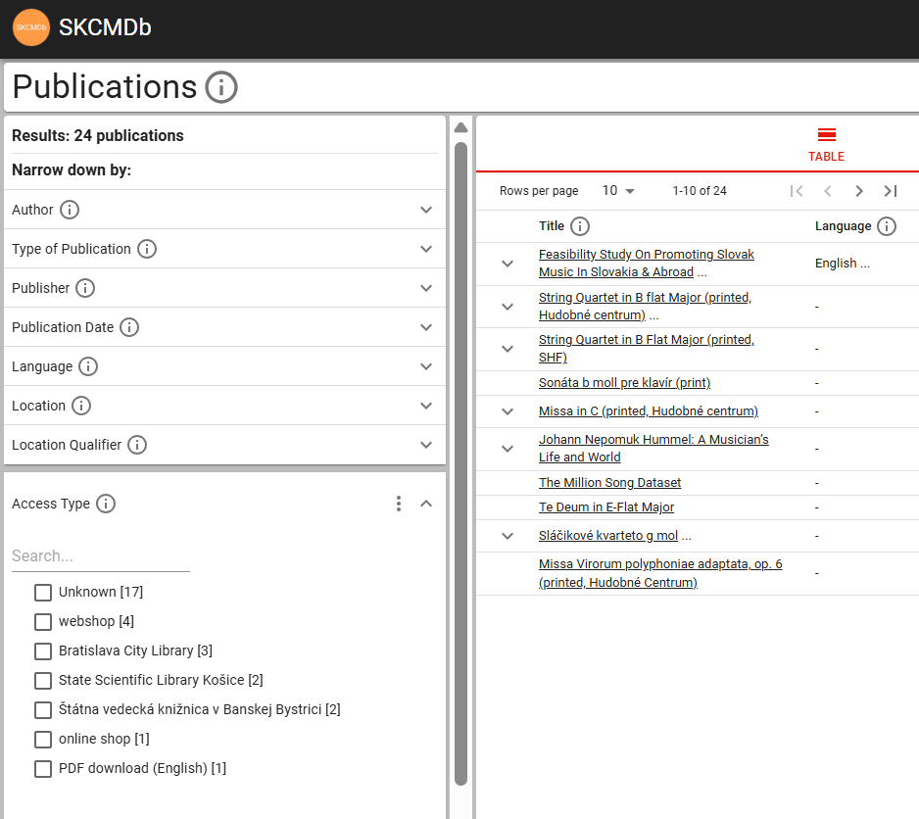
Integrating Library Services
Find scores of works in catalogues and webshops
People expect to find musical work level information (perhaps by browsing playlists of recordings)
Printed sheet music is usually a volume of several works, in which case the library catalogue may not have the work name at all.
In Slovakia, there is no centralised national catalogue system, so searching for an available sheet for loan would possibly require more than 20 searches in different catalogue systems.

Slide 22
Governance
04

Slide 23
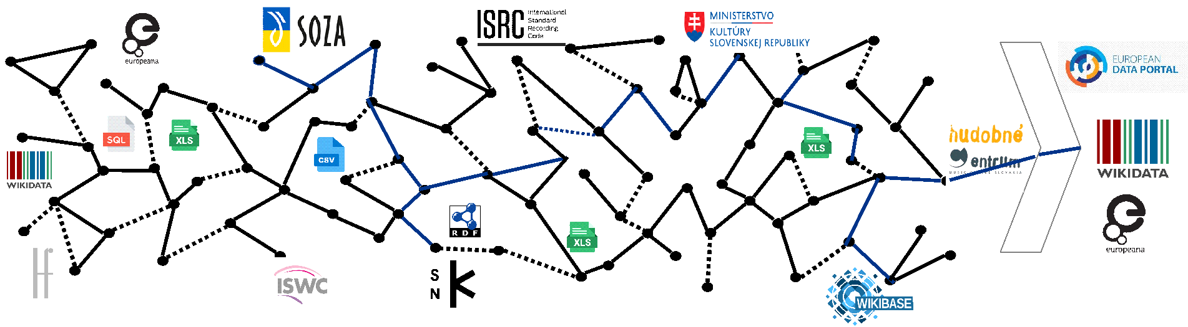
Multi-Organisation Exchange Requires Governance of Continuous Data Improvement, Better Standardisation
1. Data enrichment
Reprex consolidates the data Excel, CSV, SQL and other database (data file) formats of SOZA, Slovak Music Centre, Music Fund, and other organisations into a graph format. We assist curators to find and improve errors in their metadata. We ensure that the resulting data is more usable for rights management, heritage management, publishing.
2. Data dissemination
We send the enriched and proprietary (confidential) data to the systems of SOZA, Slovak Music Centre, Music Fund or other participants. We sent the public data to the EU Open Data Portal (statistical data), to EOSC (data of scientific value), collections data (Europeana and ECCH), and biographical and repertoire data to Wikidata and Wikpedia. This way streaming providers can use reliable data about Slovak music.

Slide 24




European Interoperability Framework: Layers of Service Interoperability
Legal interoperability
Rules of the data exchanges and use is harmonised to a level that negotiations and permits can be obtained fast to join the data.
Organisational interoperability
Organisations are harmonise their internal workflows and jobs that use data to benefit the most from improving and enriching their own data with other sharing partner’s data.
Integrated service governance
Semantic interoperability
The jobs and workflows of the organisations in the data space share a vocabulary of meanings of the collected and shared data’s definitions and meanings.
Technical interoperability
The data is translated to a standard graph format with shared annotation so that it can be easily exchanged, synchronized among partners.

Slide 25
From the Slovak music data sharing space to a bottom-up music observatory
Replicable national interoperability system: Slovak Music Dataspace
Data federation of compatible modules European Music Dataspace
Organisation for funding, rules Open European Music Observatory
Open Music Observatory
Slovak Music Dataspace
Finno-Ugric Music Dataspace
European Music Dataspace
European Music Dataspace
Hungarian Music Dataspace
music.opendataspaces.net
We create compabitle data sharing systems in countries, genres, regions on a bottom up way.
The European Music Dataspace is a federation of any dataspaces that follow our model developed in Slovakia.
We are recommending the creation of a similar organisation to Europeana.

Slide 26
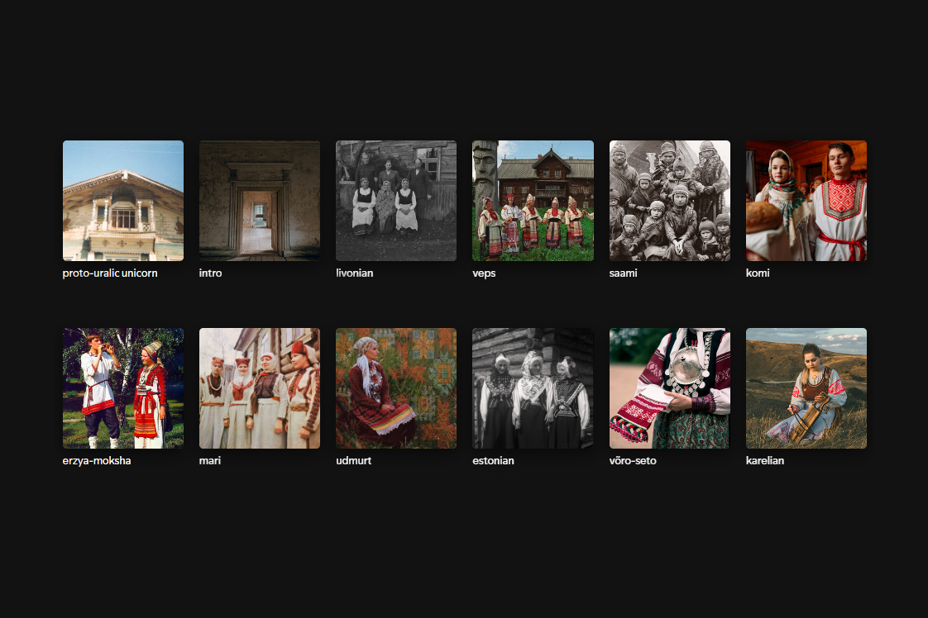
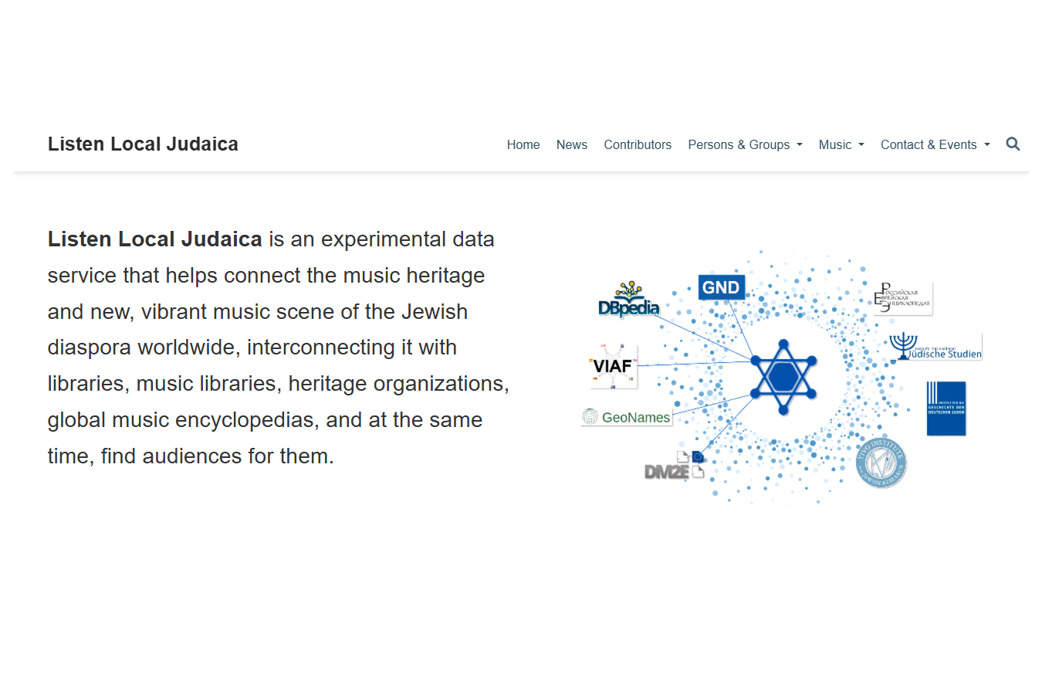
Replication: not only for national repertoires
Popular music in Finno-Ugric endangered languages and connecting Jewish music heritage

Slide 27
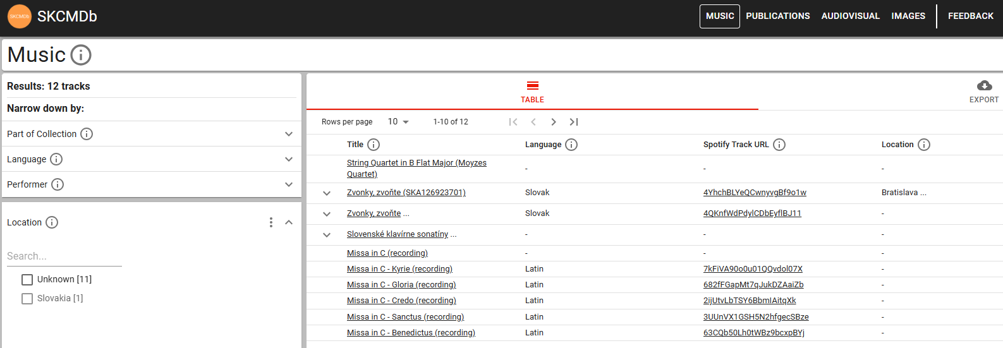
Locally Relevant Recommendations
Find music composed in Bratislava, recorded in Bratislava, or songs about Bratislava; fulfil local content guidelines for public broadcasting and commercial radio quotas.

Slide 28
Invitation: ECCCH, Europeana & European Music Observatory
05

Slide 29
Feasibility study for a European Music Observatory
Key policy document guiding our work
Identifies nearly 40 data gaps that burden both policy work and music business operations. These include data that are:
Scarce - the amount of available data is insufficient)
Fragmented - data has to be collected from numerous different sources)
Hidden - data might well exist, but cannot be found
Restricted - the data cannot be accessed due to technical or IP barriers
Unharmonised - the accessed data needs extensive and resource-intense pre-processing
We have demonstrated that many of these gaps can be filled through open data reuse, cross-stakeholder data sharing, improved surveying, harmonisation, and other novel methods.

Slide 30
Building of the EMO, modelled after the Europeana project
Vision and ambition
EUROPEAN MUSIC OBSERVATORY
Observatory Stakeholder Network
The Observatory Stakeholder Network is presented as a consulting body where future founders of the Observatory itself, and a Music Observatory Association of music data users, providers may find their future role.
Open Music Data Exchange Forum
A consultation body, similar to the Aggregators’ Forum in Europeana, for the technical solution providers or large representative stakeholders, who do not own the data, but technically they handle it.
Creating the Open Music Observatory is a cornerstone task of the OpenMusE Horizon Europe research and innovation project.
The WPs curate the “data pillars” and serve as a temporary project organization for the OMO with a gradually transition of ownership to representative stakeholders.
Open Music Project
OPEN MUSIC OBSERVATORY

Slide 31
Contacts
05

Slide 32
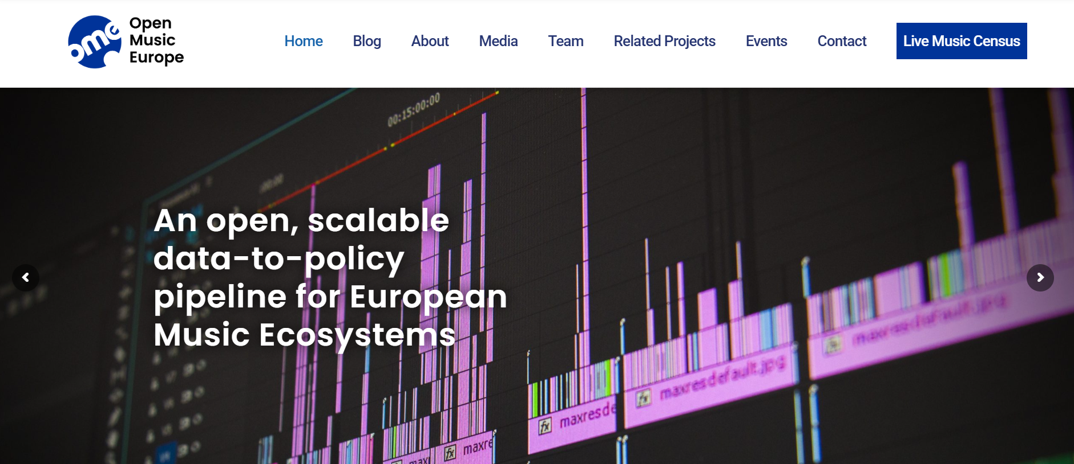
Open Music Europe: https://openmuse.eu

Slide 34




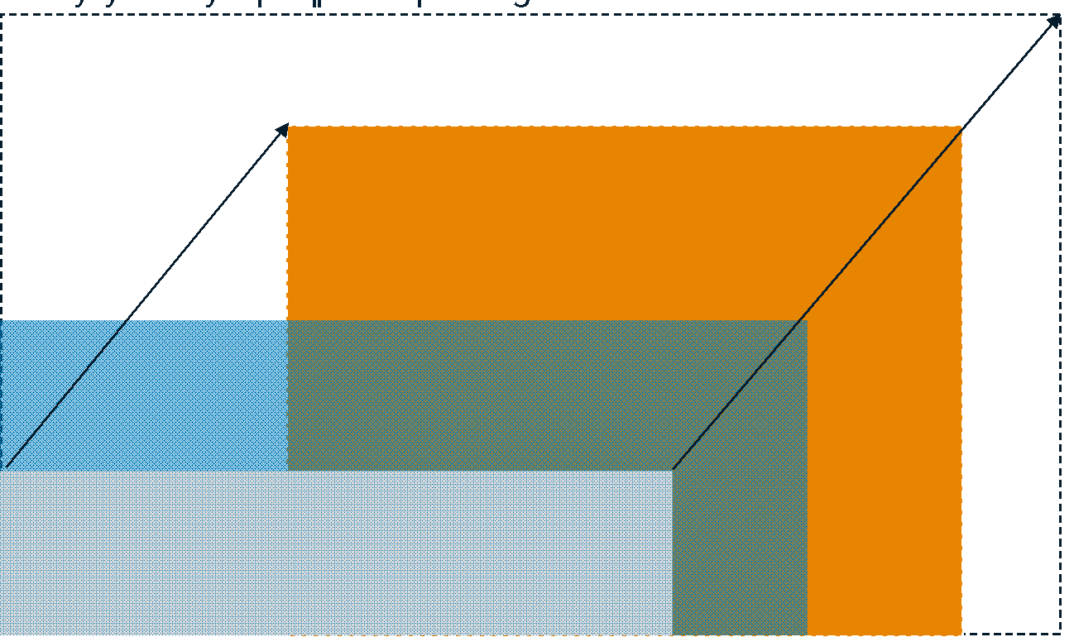
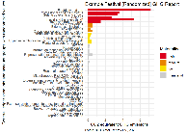
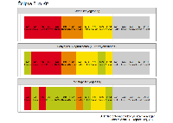





REPREX
Algorithms that work for all
Big data for all
Open technology for all
Open knowledge for all
As members of the Dutch AI Coalition, we design AI systems that organizations can trust. Our solutions meet strict regulatory and ethical standards, and are built for sensitive sectors where fairness, transparency, and accountability matter most. This is the guardrail function a strong ROI on knowledge capital.
Our data sharing space model standardizes access and governance across autonomous entities. It enables safe collaboration between companies, government, and sector partners — avoiding the pitfalls of monolithic data lakes. This is the federated foundation that your CDO does not need to build from scratch.
We maintain and extend open-source data and graph technologies, delivering them as scalable services. This provides modern infrastructure without forcing business units into heavy IT projects and often prolongs the lifespan and reduces the OPEX/CAPEX needs of existing systems.
Most organisations don’t have access to true big data — but they can tap into big knowledge. We curate shared, reliable knowledge bases from open and institutional sources. This creates knowledge capital that translates directly into business value through more efficient OPEX, better-managed CAPEX, and improved HR decisions.

Slide 35
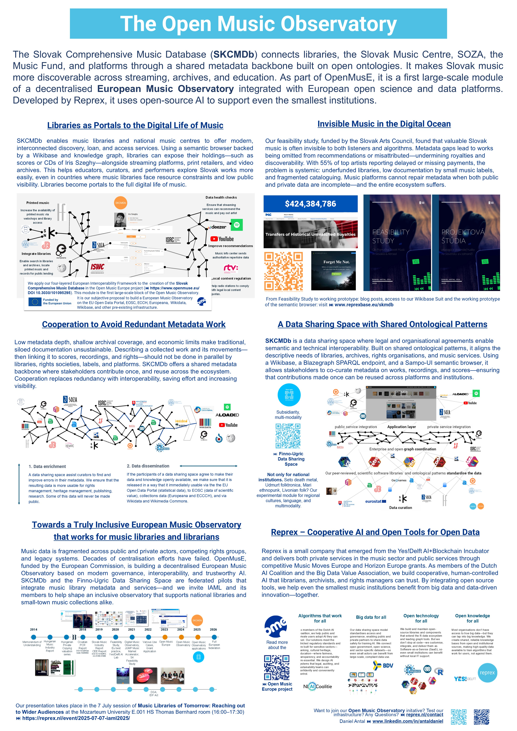
Poster & Team
Please take a look at our poster in the breaks. Credits to our team:
Slovak Music Centre: Anna Žilková
SOZA: Richard Demčák, Dr Marián Jankovič, Dominika Semaňáková
Wikipedian in Residence: Matej Grochal, Asmah Frederico
Aloaded: Stef Kragh (non-profit music distribution)
Reprex: Mester, Anna Márta (information management), Nagy, Mihály (engineering.)
Special thanks for the Ministry of Culture the Slovak National Library.

Slide 36



Thank you for your attention!
Check out our poster for a live demonstration on Tuesday
SKCMDb: reprex.nl/project/skcmdb
Daniel Antal: www.linkedin.com/in/antaldaniel

